Slide 1
ENGN 3340 / SUCCESS CENTRE
WORKSHOP 1
ARDUINO
Build a responsive LED controller with the circuit and code together.

Slide 2
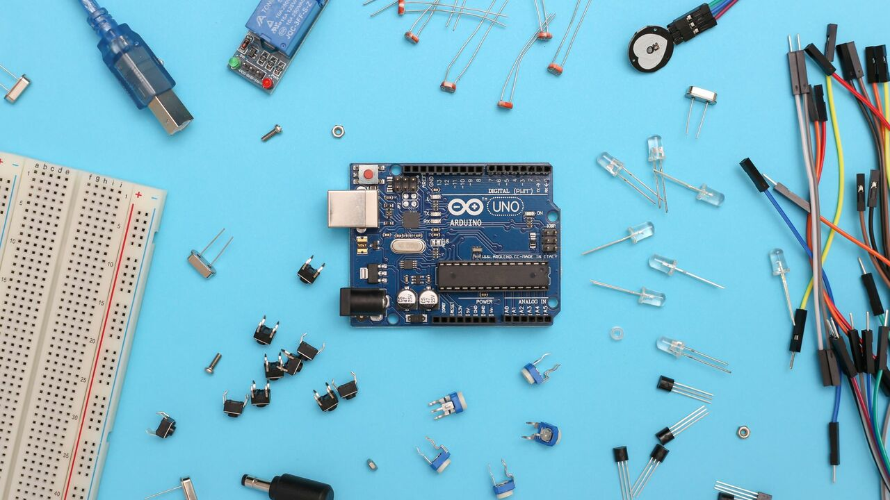
ENGN 3340 / SUCCESS CENTRE
WHAT I
NOTICED
Most people wired the LEDs. The harder part was making the code respond to inputs reliably.
Today: one circuit, one growing sketch, one new problem at a time.

Slide 3
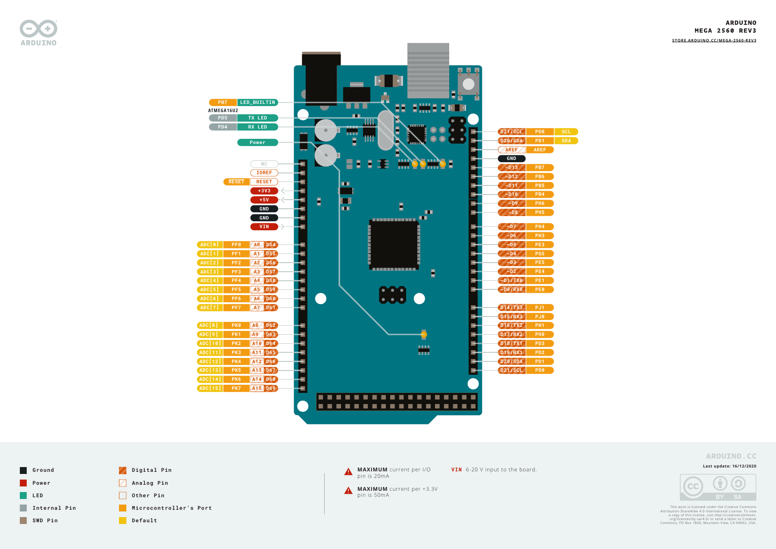
ENGN 3340 / SUCCESS CENTRE
OUR
HARDWARE
The workshop uses a Mega. Tinkercad uses an Uno, so only the pin numbers change.
Arduino Mega 2560 Rev3 pinout, Arduino (CC BY-SA 4.0).
Eight LEDs
One button
One pot
Mega D22–D29, one resistor per LED.
Mega D2 to GND; internal pull-up.
5 V, GND and the A0 wiper.

Slide 4
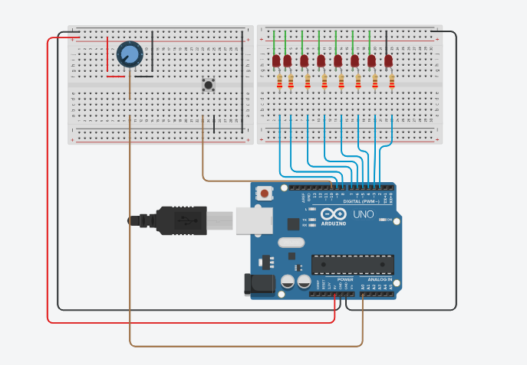
ENGN 3340 / SUCCESS CENTRE
THE
CIRCUIT
Follow the wires before reading the code. The Tinkercad build uses an Uno; the workshop sketches use a Mega.
UNO PIN MAP
D9–D2: eight LEDs, one resistor each
D10: button to GND
A0: potentiometer wiper
Workshop Tinkercad circuit, supplied by Kelenna.
Mega sketch: D22–D29 LEDs · D2 button · A0 pot

Slide 5

ENGN 3340 / SUCCESS CENTRE
KEEP PINS 0
AND 1 FREE
Use the planned pins
01
Mega: D22–D29 LEDs, D2 button, A0 pot.
INPUT_PULLUP
D0/RX0 and D1/TX0 carry USB Serial. Using them for LEDs or buttons can confuse uploads and the Serial Monitor.
02
Released reads HIGH; pressed reads LOW.
LED current path
03
Check polarity, series resistor and common GND.
Breadboard rails
04
Rails may be split. Check continuity before debugging code.
Code link: https://github.com/KelennaUdo/Arduino-Session

Slide 6
ENGN 3340 / SUCCESS CENTRE
SKETCH STRUCTURE
SKETCH STRUCTURE
void setup() {
Serial.begin(9600);
// Configure pins here.
}
void loop() {
// Read, decide and update.
}
setup() runs once. loop() repeats while the board is powered.
Notes:
Sketch 01

Slide 7
ENGN 3340 / SUCCESS CENTRE
SETUP
pinMode(buttonPin, INPUT_PULLUP);
for (int i = 0; i < ledCount; i++) {
pinMode(ledPins[i], OUTPUT);
}
SETTING PINS
pinMode() tells a digital pin whether to receive or drive a signal.
Notes:
Sketch 01

Slide 8
ENGN 3340 / SUCCESS CENTRE
DIGITAL INPUT
DIGITAL INPUT
bool buttonState = digitalRead(buttonPin);
Serial.print("button = ");
Serial.println(buttonState);
With INPUT_PULLUP, released is HIGH (1) and pressed is LOW (0). Check both in Serial Monitor.
Notes:
Sketch 01

Slide 9
ENGN 3340 / SUCCESS CENTRE
ANALOG INPUT
(POTENTIOMETER)
ANALOG INPUT
int potValue = analogRead(potPin);
Serial.println(potValue);
// Turn the knob. What changes?
Analog input converts the wiper voltage into a value from 0 to 1023.
Notes:
Sketch 01

Slide 10
ENGN 3340 / SUCCESS CENTRE
VARIABLE + ARRAY
const int ledPins[] = {
22, 23, 24, 25, 26, 27, 28, 29
};
const int ledCount = 8;
int currentLed = 0;
ARRAYS
An array groups the LED pins; currentLed selects an index from 0 to 7. Sketch 02 calculates ledCount from the array; later sketches set it to 8.
Notes:
Sketch 02

Slide 11
ENGN 3340 / SUCCESS CENTRE
FUNCTIONS AND FOR LOOPS
FUNCTION + FOR LOOP
void showLed() {
for (int i = 0; i < ledCount; i++) {
digitalWrite(ledPins[i], LOW);
}
digitalWrite(ledPins[currentLed], HIGH);
}
A function is a self-contained, reusable block of code designed to perform a specific task
This function:
Sets every LED LOW
Then sets only the current LED HIGH
Notes:
Sketch 02

Slide 12
ENGN 3340 / SUCCESS CENTRE
FORWARD SEQUENCE
ANOTHER FUNCTION
void advanceLed() {
currentLed++;
if (currentLed >= ledCount) {
currentLed = 0;
}
showLed();
}
Increment the current LED index to the next LED. After index 7, start again at 0.
Note ledCount = 8
Notes:
Sketch 03

Slide 13
ENGN 3340 / SUCCESS CENTRE
BLOCKING
OBSERVE
delay(500);
advanceLed();
// Tap the button briefly.
// Was it seen?
MAKE IT MOVE
with delay()
The LED moves, but a short button press may be missed while delay(500) blocks loop().
Notes:
Sketch 03

Slide 14
ENGN 3340 / SUCCESS CENTRE
NO DELAY()
unsigned long now = millis();
if (now - previousStep >= interval) {
previousStep = now;
advanceLed();
}
CHECK TIME
WITH millis()
The loop keeps reading inputs. The LED advances only after enough time has elapsed.
Notes:
Sketch 04

Slide 15
ENGN 3340 / SUCCESS CENTRE
ADC VALUE TO MILLISECONDS
int potValue = analogRead(potPin);
interval = map(potValue,
0, 1023,
1000, 100);
POTENTIOMETER SETS THE SPEED
A higher reading gives a shorter interval.
Notes:
Sketch 05

Slide 16
ENGN 3340 / SUCCESS CENTRE
DEBOUNCE
THE BUTTON
STABLE CHANGE
if (reading != lastReading)
buttonChangedAt = now;
if (now - buttonChangedAt >= 30 &&
reading != stableButton) {
stableButton = reading;
}
lastReading = reading;
A button can briefly flicker between HIGH and LOW. Accept its new value after it stays steady for 30 ms.
Restart timer
01
Each new reading that’s different than the previous restarts a 30-ms timer.
stableButton is a variable.
It will store only the button’s stable value.
Accept change
02
Update stableButton with the new value if they are different, and if the 30 ms timer passes (meaning the new reading was the same), then
do the thing.
Notes:
Sketch 05

Slide 17
ENGN 3340 / SUCCESS CENTRE
TOGGLE
RUN / PAUSE
INSIDE THE 30 ms CHECK
if (stableButton == LOW) {
running = !running;
if (running) previousStep = now;
}
Only a settled LOW is a press. A settled HIGH records the release without toggling again.
Press event
01
The ! operator flips a bool: RUN becomes PAUSE, and PAUSE becomes RUN.
Resume timing
02
When resuming, start a full LED interval from now.
Notes:
Sketch 05

Slide 18
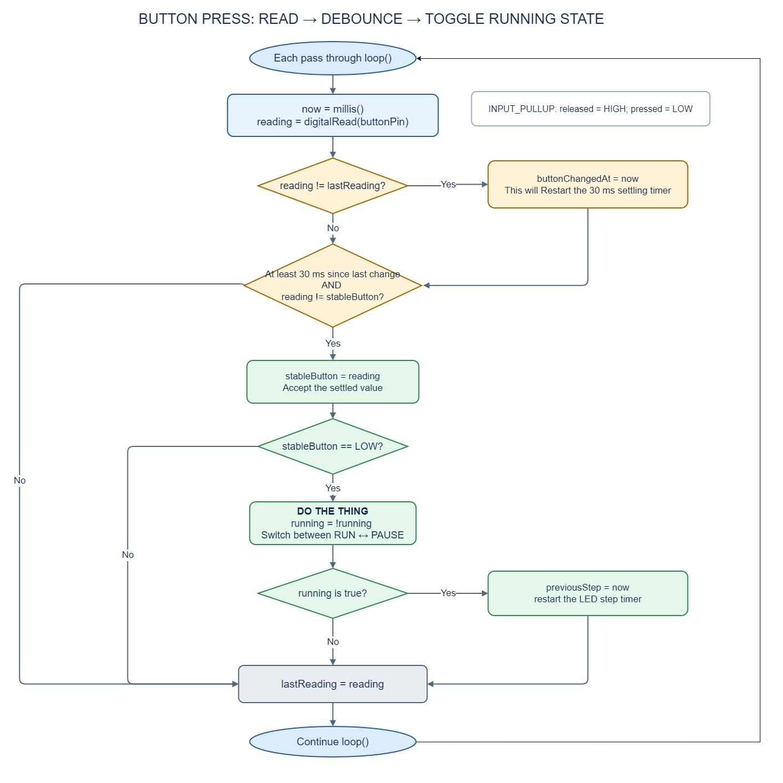
BUTTON ALGORITHM
Notes:
Sketch 05

Slide 19
ENGN 3340 / SUCCESS CENTRE
DEBUG ONE THING AT A TIME
Button
01
Released HIGH, pressed LOW?
Pot
When things behave strangely, compare the value you expect with the value you actually read.
02
Does ADC change from near 0 to 1023?
SERIAL MONITOR
Timing
03
Serial.print("LED = ");
Serial.print(currentLed);
Serial.print(" interval = ");
Serial.println(interval);
Does interval change between 1000 and 100 ms?
Output
04
Does currentLed stay between 0 and 7?
Notes:
Sketch 05

Slide 20
ENGN 3340 / SUCCESS CENTRE
SCANNER
CHALLENGE
Make the light travel 0, 1, ... 7, 6, ... 0.
Keep the potentiometer for speed, the button for RUN/PAUSE and millis().
//hint: What else must the Arduino remember in the function below?
void advanceLed() {
// TODO: bounce at each end.
currentLed++;
if (currentLed >= ledCount) currentLed = 0;
showLed();
}
Notes:
Sketch 05

Slide 21
ENGN 3340 / SUCCESS CENTRE
BEFORE
YOU LEAVE
Good and detailed coding tutorials:
https://www.youtube.com/watch?v=BLrHTHUjPuw&t=64s
https://www.youtube.com/watch?v=zJ-LqeX_fLU&t=1706s

